Slide 1
Python: lesson 1
Catherine and Annie

Slide 2
What is Python anyway?
Python is a programming language.
But what’s a programming language?
It’s a language humans use to communicate with the computer
Kind of like how you have to speak Italian if you travel to Italy
However, Python is known as a high level programming language, meaning that the computer doesn’t understand the code that you type in.
High level programming languages need to be either interpreted or compiled
Python is an interpreted language

Slide 3
Compiled vs. interpreted
A compiled language is one which uses a compiler to translate source code (the
programs you write) into machine code
A compiler is a program that you have to install on your computer
Compiled programs are translated all at once into machine code
There are two different steps: compiling, then executing
As soon as a program has been compiled, it can be run many times
Compiled languages are platform dependent, meaning there are different
compilers for different operating systems (such as Windows or Mac)
Compiled languages are considered faster than interpreted languages

Slide 4
Compiled vs. Interpreted (cont.)
An interpreted language is one which uses an interpreter to translate source code into machine code
An interpreter is also a program that you must install on your computer
Interpreted languages are platform independent, meaning that a single interpreter can be used across many different operating systems
There is a single step: executing, which starts the interpreter
The interpreter then translates and executes the source code one line at a time
Interpreted languages are considered slower than compiled ones

Slide 5

Your first program!
Now that all that boring terminology is out of the way, let’s get programming!
Click on the Windows button and at the bottom, search for IDLE
Open the program that says IDLE (Python GUI)

Slide 6
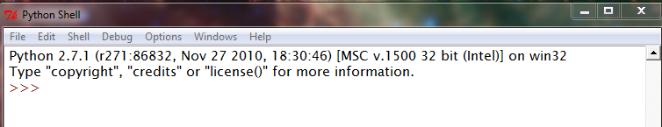
The Python shell
When you open IDLE, you should see something that looks like this:
Notice how the window says Python shell. What do you think a shell is?
A shell is a window that allows you to interact with the computer

Slide 7

More of the Python shell
With the Python shell, you can interact directly with the computer.
The set of greater than symbols ‘>>>’ is a prompt. The computer is waiting for you to give it something to do.
Try typing in 16 * 5, then press Enter, what happens?

Slide 8
Writing your first program
Typing in commands at the shell only allows you to give the computer one command at a time. What if you want to give the computer a whole bunch of instructions?
That’s when you write a program
A program is just a set of instructions for the computer
In order to write a program, you need to use a text editor, like Notepad.
IDLE comes with a text editor
At the top of the shell, click File > New window

Slide 9
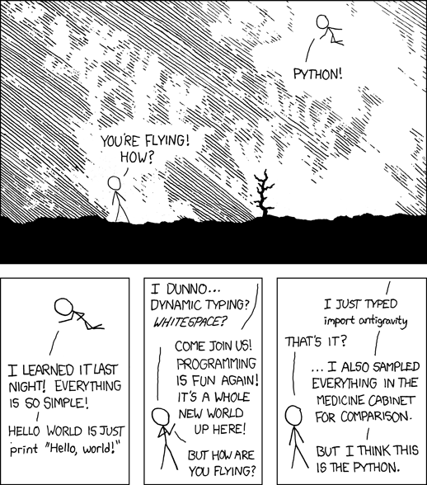
Helloworld.py
The first thing you’ll want to do is save your program. Whenever you save a Python program, you need to give it the ‘.py’ extension, so that the computer knows it’s a Python file
Kind of like ‘.doc’ is a Word document
Save your program, and call it helloWorld.py

Slide 10
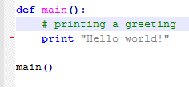
More of helloWorld.py
Type in the following
If you press Enter, what happens? NOTHING! We need to execute the program. At the top of the window, click Run > Run module

Slide 11
Breaking down hello world
Let’s take this program apart line by line
The first line reads ‘def main():’
This is called a function header. It lets the computer know that main is a function
The next line reads ‘print “Hello world!” ’
This line is a statement (an instruction given to the computer)
The line above it that begins with a # is called a comment. Comments are ignored by compilers and interpreters. They are notes to programmers.
The last line reads ‘main()’
This is a function call to main, and this is the line that actually starts the program

Slide 12
More breaking down hello world
What’s with all the indenting?
Indenting is a part of Python syntax and a good programming practice. Indenting is used to delineate chunks of code that ‘belong’ to different parts of a program. Whenever you see a colon in Python, the next line usually has to be indented.
The print statement is indented because it is part of the main function
The line that reads ‘main()’ does not belong to the main function, which is why it is not indented

Slide 13
Your Turn!
Open the file called “Python – Lesson 1 Exercises” and complete the exercises
Don’t forget the .py extension when you save your program

Slide 14

Congrats! You made it through your first programming lesson!!

